Slide 1


Kentucky Cancer Registry
Welcome!
Please Mute Devices!

Slide 2
Agenda
Today we will cover two separate topics.
  Systemic/Surgery Sequence (Frances Ross)
  COVID-19- Abstraction Guidance (Shelly Gray)

Slide 3
Coronavirus-Disease 19
(COVID-19) Abstraction Guidance
Kentucky Cancer Registry

Slide 4
Outline
COVID-19
  Clinical presentation
SARS-CoV-2 & Testing
  Test types and interpretations
Abstraction Guidelines
  New data items
Take Home Points

Slide 5
Background and Rationale
As the coronavirus 2019 (COVID-19) pandemic continues, people with compromised immune systems are at an increased risk for infection with severe acute respiratory syndrome coronavirus 2 (SARS-CoV-2), the virus that causes COVID-19.

Slide 6
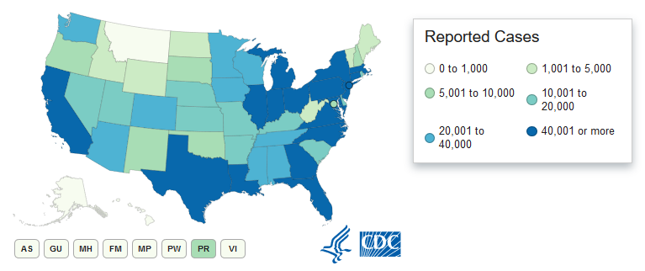
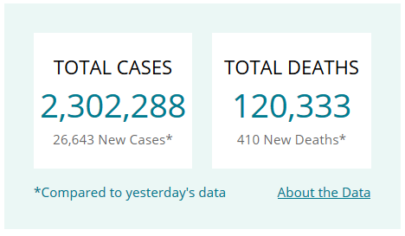
U.S. COVID-19 Cases
As of 6/24/2020

Slide 7
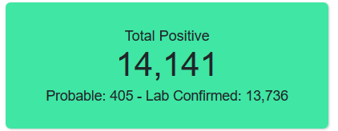
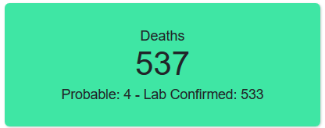
Kentucky COVID-19 Cases
As of 6/24/2020

Slide 8
COVID-19 and Cancer
It is estimated that 15,760,939 people are living with cancer in the United States.
Incidence of COVID-19 in cancer patients has been reported to be higher than in the general population.
Recent studies have shown patients with cancer had higher observed death rates, higher rates of ICU admission and higher risk of complications when compared to non-cancer patients.

Slide 9
Effects on Cancer Treatment
Radiotherapy, concurrent chemotherapy and pre-radiotherapy preparation have the option to be postponed in order to decrease the risk of infection of COVID-19 including postoperative chemotherapy.
A technical report stated that 8% of cancer patients had alterations and delays in treatment plans due to COVID-19.
For almost half of these patients, treatment was indefinitely delayed or stopped entirely due to confirmed COVID-19 infections.

Slide 10

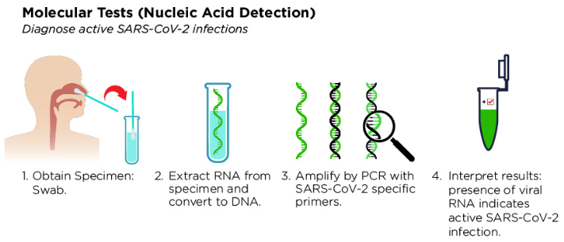
Molecular Testing
(Nucleic Acid Amplification)
KEYWORDS:
Viral
Viral Nucleic Acid
RT-PCR
RNA
Swab Test
Antigen

Slide 11
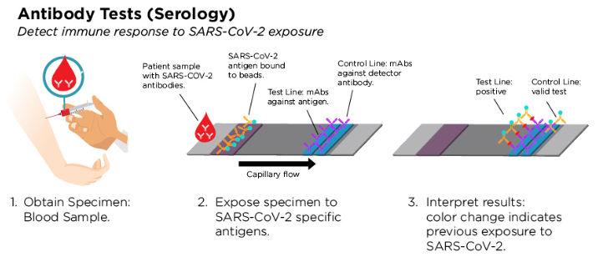
Antibody Testing (Serology)
KEYWORDS:
Antibody
Serology
Serum
Plasma
ELISA
Immune response

Slide 12
COVID-19
Abstraction Guidance

Slide 13
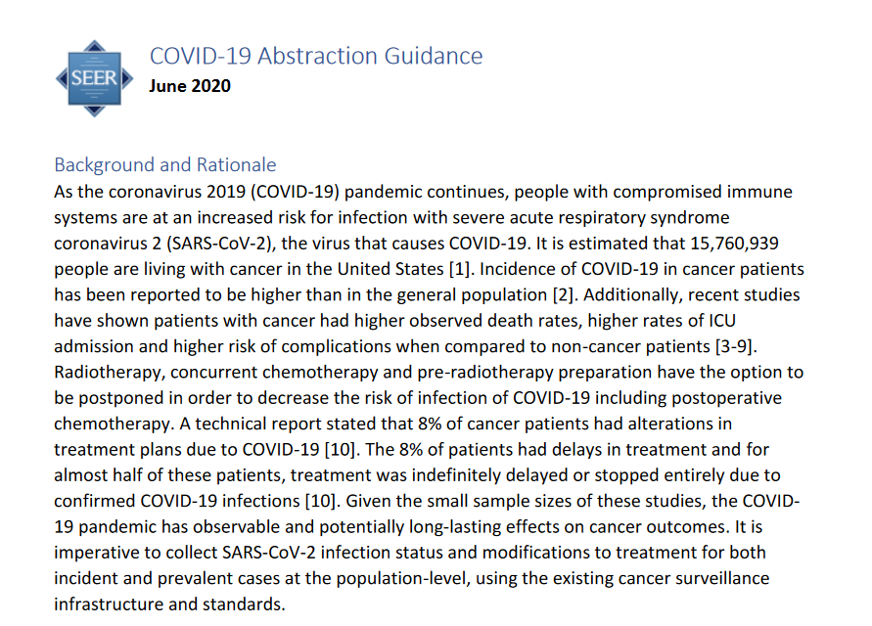
Where to find the Guidelines
https://seer.cancer.gov/tools/covid-19/COVID-19-Abstraction-Guidance.pdf

Slide 14
Data to be Abstracted
The following directions for recording COVID-19 information in the required data items are applicable to cases diagnosed January 1st, 2020 or later and completed on or after June 1st, 2020.
SARS-CoV-2 laboratory tests
Infection status
Delays or modifications of treatment

Slide 15
16 New Data Fields
COVID--ICD DIAGNOSIS CODE (U07.1)
COVID--ICD DIAGNOSIS DATE
COVID--DX PROC--LAB TEST--VIRAL
COVID--DX PROC--VIRAL TEST DATE
COVID--DX PROC--LAB TEST--ANTIBODY
COVID--DX PROC--ANTIBODY TEST DATE
DX, STAGING or TX DELAYED D/T COVID-19 (Z75.3)
DX, STAGING or TX DELAYED D/T COVID-19 (Z75.3) DATE

Slide 16
FCOT CHG D/T COVID-19--NOS
COVID RX--SURGERY
COVID RX--RADIATION (BEAM)
COVID RX--RADIATION OTHER
COVID RX--CHEMO
COVID RX--HORMONE
COVID RX--BRM
COVID--GENERAL TEXT FIELD

Slide 17
CPDMS
Each new data field will have a choice list/drop down menu.
Each field name is a hyperlink to the entry for that particular field in the Web help version of the CPDMS Abstractor’s Manual. Clicking on the field name opens a pop-up window which displays instructions for coding that data item.
Fields can be left blank if it is not applicable.
Released on July 7th.

Slide 18
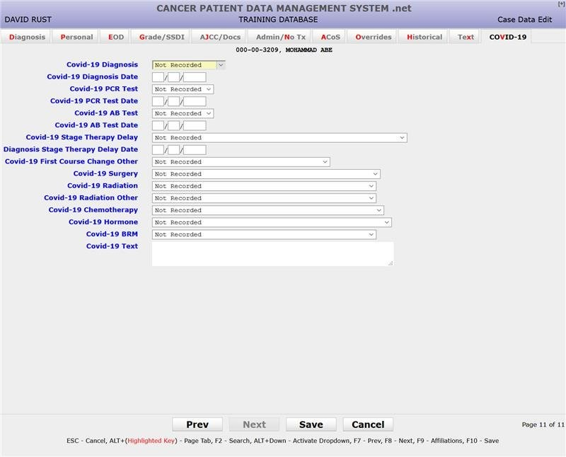
Choice list/drop down option
Each field name is a hyperlink to CPDMS Abstractor’s Manual for coding instructions

Slide 19
COVID--ICD DIAGNOSIS CODE (U07.1)
Use the COVID--ICD DIAGNOSIS CODE (U07.1) field to record a confirmed COVID-19 diagnosis.
Code only a confirmed diagnosis of the 2019 novel coronavirus disease (COVID-19) as documented by a medical provider.
  Does not require documentation of the type of test performed; the provider’s documentation that the individual has COVID-19 is sufficient.
No Ambiguous Terminology
  Do not record code U07.1 when the provider documents "suspected," "possible," "probable," or “inconclusive” any wording of a suspicion of COVID-19.

Slide 20
In addition, record code U07.1 when the code was used for diagnosis within the facility EHR, in the hospital discharge, or as a contributing or underlying cause of death.
Record code U07.1 for a lab confirmed viral/antigen test.
  IMPORTANT: Antibody tests are not diagnostic and cannot be used to assign U07.1 in the absence of documentation of COVID-19 in the medical record or death certificate and w/o a positive antigen test.
Registrars are not required to record codes for acute respiratory illness associated with COVID-19 (e.g., pneumonia, DAD, ARDS), exposure to COVID, screening for COVID, signs and symptoms without a definitive diagnosis.
Leave blank if there is no confirmed diagnosis of COVID-19.

Slide 21
COVID--ICD DIAGNOSIS DATE
Use the COVID—ICD DIAGNOSIS Date field to record the date of a confirmed COVID-19 diagnosis.
Record the date of confirmed diagnosis [test date (preferred) or office visit date].
  Alternatively, record the hospital admission date, or lastly, the hospital discharge date.
Record a partial date when interpretation is available and date is not fully known (month/year or year).
  Do not approximate the date if unknown.
  Use 99 for unknow values.
    Example: Test conducted May 2020, 05/99/2020
    Example: Test conducted in 2020, 99/99/2020
  Leave blank if there is no confirmed diagnosis of COVID-19.

Slide 22
COVID--DX PROC--LAB TEST--VIRAL
Use the COVID--DX PROC--LAB TEST--VIRAL field to record the interpretation of SARS-CoV-2 viral testing.
  COVID--DX PROC--LAB TEST--VIRAL: POS
  COVID--DX PROC--LAB TEST--VIRAL: NEG
SARS-CoV-2 viral testing is the gold-standard and is diagnostic. Code U07.1 with a positive/confirmed SARS-CoV-2 viral test.

Slide 23
Record separately viral nucleic acid testing from antibody testing.
Do not record tests with unknown type (viral nucleic acid vs. antibody).
Do not record tests with no interpretation or interpretation unknown.
Code presumptive positive COVID-19 test results as confirmed.
Leave blank if no viral nucleic acid test was performed or documented.

Slide 24
COVID--DX PROC--VIRAL TEST DATE
COVID--Dx PROC--VIRAL TEST DATE: [MM/DD/YYYY]
Record a partial date when interpretation is available and date is not fully known (month/year or year).
  Do not approximate the date if unknown.
  Use 99 for unknow values.
    Example: Test conducted May 2020, 05/99/2020
    Example: Test conducted in 2020, 99/99/2020
    Leave blank if no viral nucleic acid test was performed or documented.

Slide 25
Directions when multiple tests with interpretation are available:
  Record the date of the first positive viral nucleic acid test when multiple interpretations are available for multiple tests.
  Record the interpretation and date of the last negative viral nucleic acid test when no positive tests are available, but one or multiple negative SARS-CoV-2 viral nucleic acid are documented.

Slide 26
COVID--DX PROC--LAB TEST--ANTIBODY
Use the COVID--DX PROC--LAB TEST--ANTIBODY field to record the interpretation of SARS-CoV-2 antibody testing.
  COVID--DX PROC--LAB TEST--ANTIBODY: POS
  COVID--DX PROC--LAB TEST--ANTIBODY: NEG
SARS-CoV-2 antibody testing is not diagnostic. Do not code U07.1 with a positive/confirmed SARS-CoV-2 antibody test in the absence of documentation of COVID-19 in the medical record or death certificate and w/o a positive antigen test.

Slide 27
Record separately viral nucleic acid testing from antibody testing.
Always record the interpretation and date of the latest (most recent) positive antibody testing.
Do not record tests with unknown type (viral nucleic acid vs. antibody).
Do not record tests with no interpretation or interpretation unknown.
Code presumptive positive COVID-19 test results as confirmed.
Leave blank if no antibody test was performed or documented.

Slide 28
COVID--DX PROC--ANTIBODY TEST DATE
COVID--Dx PROC--ANTIBODY TEST DATE: [MM/DD/YYYY]
Always record the interpretation and date of the latest (most recent) positive antibody testing.
Record a partial date when interpretation is available and date is not fully known (month/year or year).
  Do not approximate the date if unknown.
  Use 99 for unknow values.
    Example: Test conducted May 2020, 05/99/2020
    Example: Test conducted in 2020, 99/99/2020
    Leave blank if no antibody test was performed or documented.

Slide 29
DX, STAGING or TX DELAYED D/T COVID-19 (Z75.3)
ICD-10: Z75.3 Unavailability and inaccessibility of health-care facilities
Use the DX, STAGING or TX DELAYED D/T COVID-19 (Z75.3) field when diagnosis, staging, treatment (any modality), or other cancer management events have been delayed because of limited access to facilities or postponement of non-essential procedures due to COVID-19, abstract the date of decision to postpone and the Z75.3 code
Record the following information for all cancer patients (when applicable) regardless of whether or not they have a COVID-19 diagnosis or test.
No recording is necessary when the first course of treatment was not delayed, rescheduled or otherwise modified because of the COVID pandemic.

Slide 30
DX, STAGING or TX DELAYED D/T COVID-19 (Z75.3) DATE
DX, STAGING or TX DELAYED D/T COVID-19 (Z75.3) DATE : [MM/DD/YYYY]
Abstract the date of decision to postpone.
Record a partial date when interpretation is available and date is not fully known (month/year or year).
  Do not approximate the date if unknown.
  Use 99 for unknow values.
    Example: Test conducted May 2020, 05/99/2020
    Example: Test conducted in 2020, 99/99/2020
    Leave blank when the first course of treatment was not delayed, rescheduled or otherwise modified because of the COVID pandemic.

Slide 31
FCOT CHG D/T COVID-19--NOS
Use the DX, STAGING or TX DELAYED D/T COVID-19—NOS field, when first course of treatment was modified because of COVID-19 and no other specific details are provided in the medical record.
Record the following information for all cancer patients (when applicable) regardless of whether or not they have a COVID-19 diagnosis or test.
No recording is necessary when the first course of treatment was not delayed, rescheduled or otherwise modified because of the COVID pandemic.

Slide 32
DX, STAGING or TX DELAYED D/T COVID-19 (Z75.3) and NOS
The abstracter can use both FCOT and Z75.3 at the same time. This combo is required when multiple steps of cancer management (diagnosis, staging, treatment modalities) were affected by unavailability or inaccessibility of oncology care.
  Example: Doctors note states: on 3/17/2020 met with patient, due to COVID-19, facility A is not accepting patients. Treatment will be delayed and will be started at Facility B.

Slide 33
Treatment Modifications
DC D/T COVID-19 (Discontinued)
CHG D/T COVID-19 (Changed)
DELAYED D/T COVID-19 (Delayed)
DELAYED D/T COVID-19 & GIVEN AS SUB TX AFTER PROG (Delayed & given after progression)
Record the following information for all cancer patients (when applicable) regardless of whether or not they have a COVID-19 diagnosis or test.
No recording is necessary when the first course of treatment was not delayed, rescheduled or otherwise modified because of the COVID pandemic.

Slide 34
COVID RX--SURGERY
Use the COVID RX--SURGERY field to record information about surgery delays or modifications due to COVID-19.
Rationale:
  This data item is intended to identify whether the timing and type of surgical treatment offered to the patient given the site/histology/stage of disease present at diagnosis was impacted because of the COVID-19 pandemic.
Record the following information for all cancer patients (when applicable) regardless of whether or not they have a COVID-19 diagnosis or test.
No recording is required if the first course of treatment was not delayed, rescheduled or otherwise modified.

Slide 35
If COVID-19 impacted the timing or surgical options offered, one of five following situations is to be captured in this field.
  SURG DC D/T COVID-19
    Surgery was not performed due to COVID-19.
  SURG CHG D/T COVID-19
    Type of surgery offered and performed was changed/modified from what is typically recommended due to COVID-19.
  SURG DELAYED D/T COVID-19
    Typical surgery recommended was performed but it was delayed due to COVID-19.

Slide 36
  SURG DELAYED & CHG D/T COVID-19
    Type of surgery offered and performed was changed/modified from what is typically recommended due to COVID-19 and it was delayed.
  SURG DELAYED D/T COVID-19 & GIVEN AS SUB TX AFTER PROG
    Surgical treatment was recommended before but administered after disease progression.
    Delayed treatment MAY be collected as subsequent therapy but is not required.

Slide 37
COVID RX—RADIATION (BEAM)
Use the COVID RX-RADIATION (BEAM) field to record information about beam radiation delays, discontinuation, or modifications due to COVID-19.
Rationale:
  This data item is intended to identify whether the timing and type of beam radiation treatment offered to the patient given the site/histology/stage of disease present at diagnosis was impacted because of the COVID-19 pandemic.
Record the following information for all cancer patients (when applicable) regardless of whether or not they have a COVID-19 diagnosis or test.
No recording is required if the first course of treatment was not delayed, rescheduled or otherwise modified.

Slide 38
If COVID-19 impacted the timing of beam radiation treatment options offered, one of four following situations is to be captured in this field.
  XRT DC D/T COVID-19
    When medical documentation is available to indicate that beam radiation was discontinued because of COVID-19 pandemic.
  XRT CHG D/T COVID-19
    When medical documentation is available to indicate that beam radiation was changed because of COVID-19 pandemic.

Slide 39
  XRT DELAYED D/T COVID-19
    When medical documentation is available to indicate that initiation of beam radiation planning or administration was delayed because of COVID-19 pandemic.
  XRT DELAYED D/T COVID-19 & GIVEN AS SUB TX AFTER PROG
    When radiation (beam) was recommended before but administered after disease progression.
    Delayed treatment MAY be collected as subsequent therapy but is not required.

Slide 40
COVID--RX TEXT--RADIATION OTHER
Use the COVID RX--RADIATION OTHER field to record information about RT and/or ICB radiation delays, discontinuation, or modifications due to COVID-19
Rationale:
  This data item is intended to identify whether the timing and type of brachytherapy and/or systemic therapy of radiation other than beam treatment offered to the patient given the site/histology/stage of disease present at diagnosis was impacted because of the COVID-19 pandemic.
Record the following information for all cancer patients (when applicable) regardless of whether or not they have a COVID-19 diagnosis or test.
No recording is required if the first course of treatment was not delayed, rescheduled or otherwise modified.

Slide 41
If COVID-19 impacted the timing of RT and/or ICB radiation treatment options offered, one of eight following situations is to be captured in this field.
  RT DC D/T COVID-19
    When medical documentation is available to indicate that systemic therapy of radiation other than beam was discontinued because of COVID-19 pandemic.
  RT CHG D/T COVID-19
    When medical documentation is available to indicate that systemic therapy of radiation other than beam was changed because of COVID-19 pandemic.
  RT DELAYED D/T COVID-19
    When medical documentation is available to indicate that initiation systemic therapy of radiation other than beam planning or administration was delayed because of COVID-19 pandemic.

Slide 42
  RT DELAYED D/T COVID-19 & GIVEN AS SUB TX AFTER PROG
    When systemic therapy of radiation other than beam was recommended before but administered after disease progression.
    Delayed treatment MAY be collected as subsequent therapy but is not required.
  ICB DC D/T COVID-19
    When medical documentation is available to indicate that brachytherapy was discontinued/plan changed because of COVID-19 pandemic.
  ICB CHG D/T COVID-19
    When medical documentation is available to indicate that brachytherapy was changed because of COVID-19 pandemic.

Slide 43
  ICB DELAYED D/T COVID-19
    When medical documentation is available to indicate that initiation of brachytherapy planning or administration was delayed because of COVID-19 pandemic.
  ICB DELAYED D/T COVID-19 & GIVEN AS SUB TX AFTER PROG
    When brachytherapy was recommended before but administered after disease progression.
    Delayed treatment MAY be collected as subsequent therapy but is not required.

Slide 44
Directions when both brachytherapy and systemic therapy of radiation other than beam treatment offered to the patient was impacted because of the COVID-19 pandemic.
  In the COVID RX--RADIATION Other field, record the treatment that was to be delivered first within the original treatment plan.
  Captured the remaining treatment, in the COVID--GENERAL TEXT FIELD.
  Data item fields must be typed in exactly as shown in the COVID--GENERAL TEXT FIELD to facilitate data retrieval at a later time.

Slide 45
COVID RX--CHEMO
Use the COVID RX-Chemo field to record information about chemotherapy delays, discontinuation, or modifications due to COVID-19.
Rationale:
  This data item is intended to identify whether the timing and type of chemotherapy treatment offered to the patient given the site/histology/stage of disease present at diagnosis was impacted because of the COVID-19 pandemic.
Record the following information for all cancer patients (when applicable) regardless of whether or not they have a COVID-19 diagnosis or test.
No recording is required if the first course of treatment was not delayed, rescheduled or otherwise modified.

Slide 46
If COVID-19 impacted the timing of chemotherapy treatment options offered, one of four following situations is to be captured in this field.
  CHEMO DC D/T COVID-19
    When medical documentation is available to indicate that chemotherapy regimen was discontinued or not initiated because of COVID-19 pandemic.
  CHEMO CHG D/T COVID-19
    When medical documentation is available to indicate that chemotherapy regimen was changed (e.g. infusion to oral, reduction in the number of cycles, etc.) because of COVID-19 pandemic.

Slide 47
  CHEMO DELAYED D/T COVID-19
    When medical documentation is available to indicate that initiation of chemotherapy administration was delayed because of COVID-19 pandemic.
  CHEMO DELAYED D/T COVID-19 & GIVEN AS SUB TX AFTER PROG
    When chemotherapy was recommended before but administered after disease progression.
    Delayed treatment MAY be collected as subsequent therapy but is not required.

Slide 48
COVID RX--HORMONE
Use the COVID RX-Hormone field to record information about hormone therapy delays, discontinuation, or modifications due to COVID-19.
Rationale:
  This data item is intended to identify whether the timing and type of hormone treatment offered to the patient given the site/histology/stage of disease present at diagnosis was impacted because of the COVID-19 pandemic.
Record the following information for all cancer patients (when applicable) regardless of whether or not they have a COVID-19 diagnosis or test.
No recording is required if the first course of treatment was not delayed, rescheduled or otherwise modified.

Slide 49
If COVID-19 impacted the timing of hormone treatment options offered, one of four following situations is to be captured in this field.
  HORMONE DC D/T COVID-19
    When medical documentation is available to indicate that hormone administration was discontinued or not initiated because of COVID-19 pandemic.
  HORMONE CHG D/T COVID-19
    When medical documentation is available to indicate that hormone prescription was changed because of COVID-19 pandemic.

Slide 50
  HORMONE DELAYED D/T COVID-19
    When medical documentation is available to indicate that initiation of hormone administration was delayed because of COVID-19 pandemic.
  HORMONE DELAYED D/T COVID-19 & GIVEN AS SUB TX AFTER PROG
    When hormonal therapy was recommended before but administered after disease progression.
    Delayed treatment MAY be collected as subsequent therapy but is not required.

Slide 51
COVID RX--BRM
Use the COVID RX--BRM field to record information about BRM or immunotherapy delays, discontinuation, or modifications due to COVID-19.
Rationale:
  This data item is intended to identify whether the timing and type of immunotherapy (or bone marrow/stem cell transplant) treatment offered to the patient given the site/histology/stage of disease present at diagnosis was impacted because of the COVID-19 pandemic.
Record the following information for all cancer patients (when applicable) regardless of whether or not they have a COVID-19 diagnosis or test.
No recording is required if the first course of treatment was not delayed, rescheduled or otherwise modified.

Slide 52
If COVID-19 impacted the timing of immunotherapy (or bone marrow/stem cell transplant) treatment options offered, one of eight following situations is to be captured in this field.
  BRM DC D/T COVID-19
    When medical documentation is available to indicate that immunotherapy administration was discontinued or not initiated because of COVID-19 pandemic.
  BRM CHG D/T COVID-19
    When medical documentation is available to indicate that immunotherapy administration was changed (i.e. reduction in the number of cycles) because of COVID-19 pandemic.
  BRM DELAYED D/T COVID-19
    When medical documentation is available to indicate that initiation of immunotherapy administration was delayed because of COVID-19 pandemic.

Slide 53
  BRM DELAYED D/T COVID-19 & GIVEN AS SUB TX AFTER PROG
    When immunotherapy was recommended before but administered after disease progression.
    Delayed treatment MAY be collected as subsequent therapy but is not required.
  BMT DC D/T COVID-19
    When medical documentation is available to indicate that bone marrow/stem cell transplant administration was discontinued or not initiated because of COVID-19 pandemic.
  BMT CHG D/T COVID-19
    When medical documentation is available to indicate that bone marrow/stem cell transplant administration was changed (i.e. reduction in the number of cycles) because of COVID-19 pandemic.

Slide 54
  BMT DELAYED D/T COVID-19
    When medical documentation is available to indicate that initiation of bone marrow/stem cell transplant was delayed because of COVID-19 pandemic.
  BMT DELAYED D/T COVID-19 & GIVEN AS SUB TX AFTER PROG
    When bone marrow/stem cell transplant was recommended before but administered after disease progression.
    Delayed treatment MAY be collected as subsequent therapy but is not required.

Slide 55
Directions when both immunotherapy and bone marrow/stem cell transplant treatment offered to the patient was impacted because of the COVID-19 pandemic.
  In the COVID RX--BRM field, record the treatment that was to be delivered first within the original treatment plan.
  Captured the remaining treatment, in the COVID--GENERAL TEXT FIELD.
  Data item fields must be typed in exactly as shown in the COVID--GENERAL TEXT FIELD to facilitate data retrieval at a later time.

Slide 56
COVID--GENERAL TEXT FIELD
Use the COVID--GENERAL TEXT field to record information about delays, discontinuation, or modifications in treatments due to COVID-19 that the above data drop down options were not able to capture.
  Additional treatments that were delayed (RT or ICB)(BRM or BMT).
  Any additional information that you feel tells the patients story.

Slide 57
Take Home Points
The following directions for recording COVID-19 information in the required data items are applicable to cases diagnosed January 1st, 2020 or later and completed on or after June 1st, 2020.
Use U07.1 for a confirmed COVID-19 diagnosis as documented by a medical provider.
Record the following information for all cancer patients (when applicable) regardless of whether or not they have a COVID-19 diagnosis or test.
Use fields when cancer diagnosis, staging, treatment (any modality), or other cancer management events have been modified due to COVID-19, regardless of COVID-19 diagnosis status.
No recording is required if the first course of treatment was not delayed, rescheduled or otherwise modified.

Slide 58
QUESTIONS?
Shelly Gray
QA Manager of Abstracting and Training
Kentucky Cancer Registry
Office: 859-218-2101
E-mail: michelle.gray@uky.edu

